Slide 1
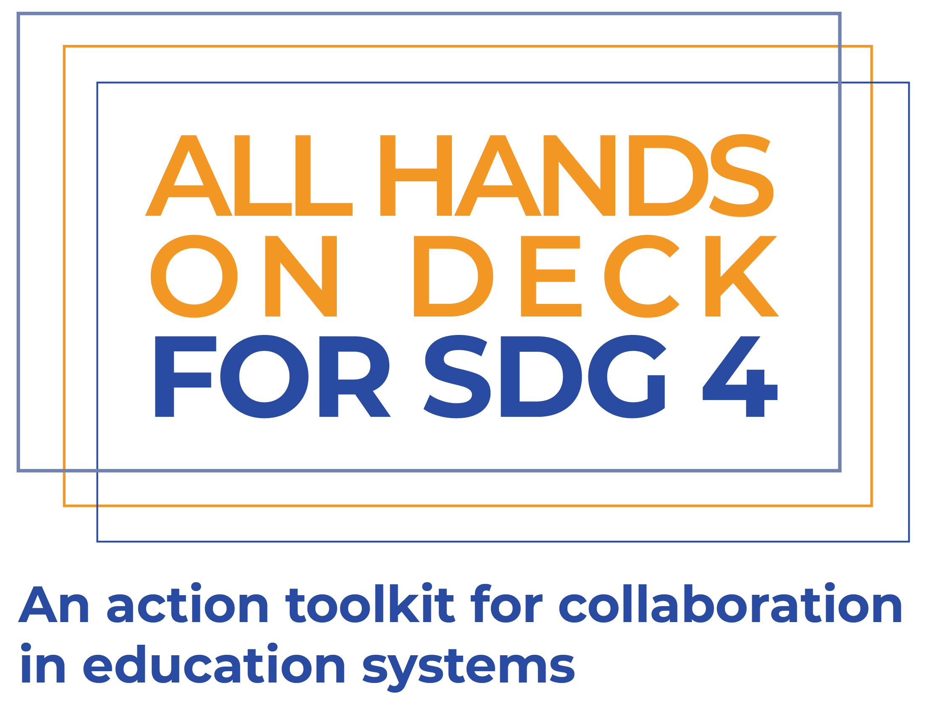
Workshop Presentation

Slide 2
Purpose for This Session
By the end of this session, you should:
Have a good understanding of what has been learned through the All Hands On Deck For SDG 4 project
Be able to define what characteristics, assets and opportunities will support your work
Understand how to shape your activities to better foster engagement
Be able to articulate your theory for how your activities will foster better engagement
The purpose for this session is to use what we have learned through the All Hands On Deck For SDG 4 research to support you as non-state organisations in defining (or refining) your strategy for how you will use your current activities to build stronger engagement with the government.

Slide 3
Agenda
Introduction What is All Hands On Deck For SDG 4? | What is our starting point and purpose? | 9:00 – 9:30
Step 1 : What is your Starting Point What is the challenge you face and your long-term goal? | 9:30 – 10:00
Break (10:00 – 10:15) | 10:00 – 10:15
Step 2: Enablers of Change What assets do you have? | What opportunities exist around you? | 10:15 – 11:45
Break (11:45 – 12:00) | 11:45 – 12:00
Step 3: Activities What do you do? | How can you do it more effectively? | 12:00 – 13:30
Lunch (13:30 – 14:30) | 13:30 – 14:30
Step 4: Pathways to Change Linking it together in a framework for action | 14:30 – 16:00
Break (16:00 – 16:15) | 16:00 – 16:15
Conclusions and Next Steps | 16:15 - 17:00

Slide 4
What is All Hands On Deck For SDG 4
Introducing the research and framework for action

Slide 5
Four Case Studies
The Regional Education Learning Initiative (RELI)
RELI is a coalition of more than 70 non-state and civil society organisations working in education in Kenya, Tanzania, and Uganda. Formed in 2017, RELI aims to generate evidence to support governments in improving education quality.
Engagement between the Ministry of Education and private schools in Lagos State
Most learners in Lagos State are in low-fee private schools, but until 2008 the number of schools wasn’t known. Beginning with a DfID-funded school census, a constellation of organisations has been working to improve the quality of engagement between the MoE and private schools.
Transforming Education in Cocoa Communities (TRECC)
TRECC was a collaboration between the Jacobs Foundation, the government of Côte d’Ivoire and a network of cocoa-producers. The initiative aimed to reduce child labour in cocoa communities through joint funding and management of pilots to find innovations to improve education quality. These innovations could then be scaled up in the government system.
The private schools work of the Central Square Foundation (CSF)
CSF’s work on private schools aims to improve the quality of education in the private sector by a) improving the quality of data on learning outcomes, thereby supporting informed parental choice, b) supporting improved regulation of private schools, and c) using evidence to build more productive narratives around private schooling.

Slide 6
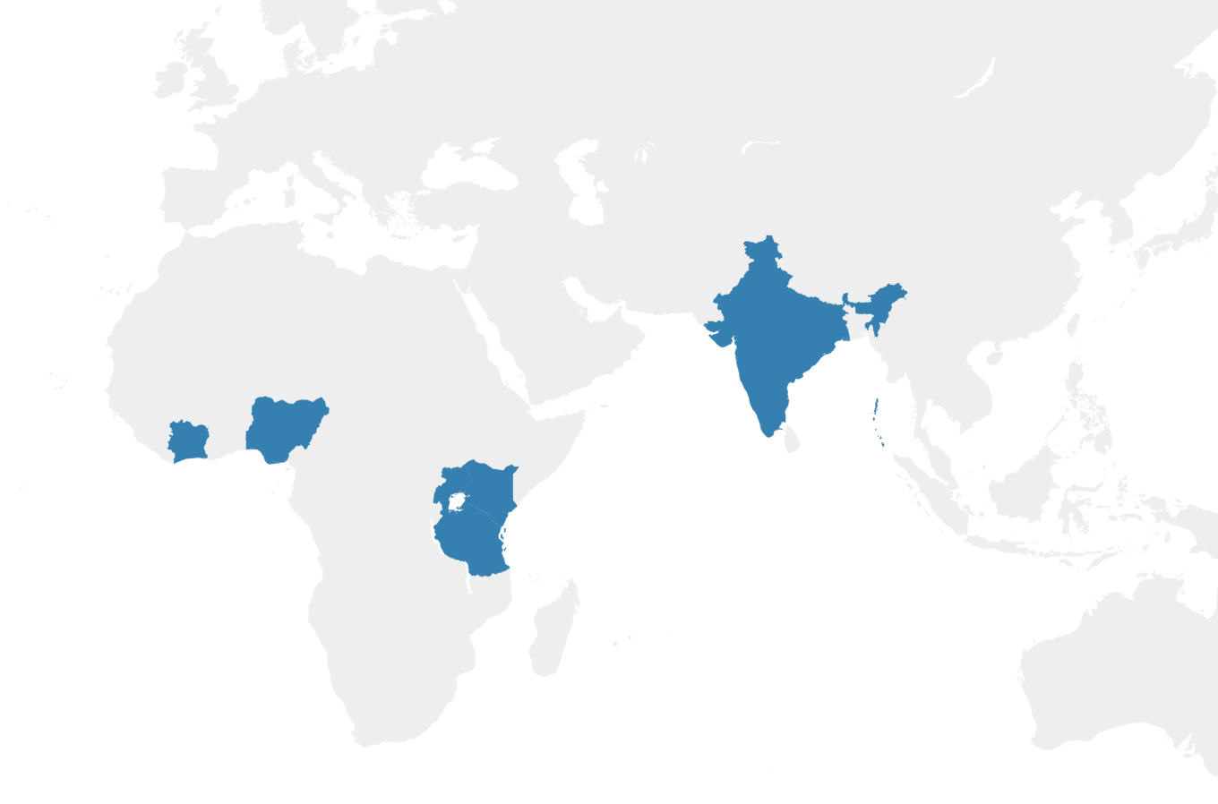
Why these cases?
We chose our case studies to learn more about how engagement is built through:
Coalition building between non-state actors (RELI)
Non-traditional partnerships of state and non-state actors (TRECC)
Generating evidence to create and sustain new narratives around engagement (CSF)
Eco-system collaboration over long periods of time (Lagos State)
TRECC
Côte d’Ivoire
Central Square Foundation (various states in India)
Lagos State
Nigeria
Regional Education Learning Initiative (RELI)
Kenya, Tanzania & Uganda
Notes:
In addition, all of the case studies had evidence of impact

Slide 7
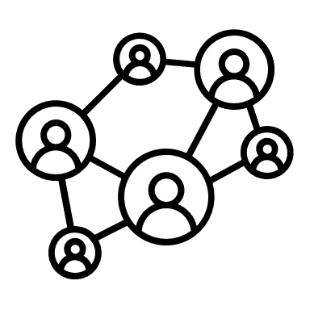
The Action Framework
3
Activities to build Engagement
Lack of data & evidence and shared understanding on non-state actors
Policy Windows
A shared understanding, trust and common goals
What can be done…
Timing
Opportunities
Data & Evidence Generation
Trust Building
A mindset that sees non-state education as outside public policy
Political and Social Context
Evidence & data to understand and act
System Level Goal
Public & private operate as one system, supported by government oversight & partnerships; and delivering goals of equity & learning
Ecosystems
1
Problem Statements
Coalition Building
Issue Framing
2
Enablers of Change
Tested policy solutions
Lack of policy & delivery solutions for public-private collaboration
Technical Capabilities
Alignment
Catalytic Funding
Modelling & Testing solutions
Characteristics and Assets
Lack of catalytic funding & platforms to support public-private collaboration
Funding, platforms & delivery partners to implement solutions
…for what purpose
Commitment
Skilful Leadership
4
Outcomes of Increased Engagement

Slide 8
The Action Framework
1
2
3
4
System Level Goal
Problem Statements
Enablers of Change
Activities to Build Engagement
Outcomes of Increased Engagement
What problems are causing a lack of positive engagement between state and non-state actors where you work?
What opportunities exist to improve engagement?
What assets do you have to support your work?
What activities do you currently have which can build engagement?
What can you do to strengthen them?
In your case, what would improved engagement look like? What would change if there was improved engagement?
Public & private operate as one system, supported by government oversight & partnerships; and delivering goals of equity & learning
Notes:
Adaptation Note:
This simplified version of the action framework can be used instead of the previous slide. It is a simplification which can help to avoid overloading participants with too much information early in the workshop. Each of the points is explained fully later in the presentation.

Slide 9
Steps for Putting it into Practice
3
1
4
Step 3: Reflect on your activities
What is it you do as an organisation? We will use this session to reflect on your current work and how it can support building engagement with government.
Step 1: Define your goals
What is the challenge that you are currently trying to overcome. If we can define that, we can think about an ideal future, and how we can reach it.
Step 4: Link activities to outcomes
Once you know the opportunities that exist, and what activities you have, we will use these to build a plan of action for your work on building engagement. This will link your activities to a defined problem, and a set of outcomes.
2
Step 2: Map your enablers
Before planning activities, we can take time to think through what assets you have as an organisation that will support your work, and what opportunities exist in your context.

Slide 10
1
Your starting point
What is the challenge you are trying to overcome, and the future you are working towards?

Slide 11
What is All Hands On Deck For SDG 4?
The Problem
To frame the purpose for All Hands On Deck for SDG 4, we have defined a goal, a challenge, an imaginable future, and a pathway to reach that future.
The affordable non-state sector, including low-fee or no-fee private schools, religious schools, and the ancillary services which support them, are often not engaged to support governments in policy planning, dialogue, implementation, and monitoring. This limits the diversity of experiences involved in formulating and implementing policies to expand inclusion to education.
The Goal
The inclusion of all non-state education providers working in underserved communities in government policy planning, dialogue, implementation, and monitoring.

Slide 12
Where are we going?
Imagining the future
In an ideal future, governments, as duty bearers for education, will be able to rely on expertise from all non-state actors involved in education. This would allow them to leverage the different experiences and expertise that exist within the affordable non-state sector, helping to contribute to policy dialogue and delivery, to expand equitable access to quality education.
How are we helping to get there
The All Hands on Deck strategy guide aims to support greater engagement between non-state actors and governments by:
Using the literature on systems change to develop our understanding of how initiatives can lead to systemic change through better engagement between state and non-state actors.
Using that understanding to develop case studies of successful initiatives which have shifted narratives to more productive engagement between state and non-state sectors.
Create a publicly available toolkit based on the case studies, to guide non-state actors through their planning for increasing productive engagements with governments.

Slide 13
Activity 1 – Goal Setting
Use goal-setting sheet to set out:
What is your goal for fostering more productive engagement with government?
What challenges do you face in doing this?
What does an ideal future look like for you?
How can this workshop support you in getting here?
Now present what you have worked on to the person next to you. Did you have similar reflections and intentions? What was the same, and what was different?

Slide 14
2
Enablers of change
How does who you are, and where you work, affect what you do?

Slide 15
Enablers of Change
Characteristics and Assets |  |  | Opportunities
Commitment | Change is fostered by commitment. This can be achieved by local organisations with deep roots, or outside organisations willing to make long term commitments. |  | Timing | Change takes time, and enacting change relies on patience to wait for change, trust to persist with activities, and opportunism to act when opportunities arise.
Alignment | This means alignment within an organisation, in terms of having a clearly defined, consistent message, as well as alignment with government priorities and policies. |  | Policy Windows | Opportunities for change can arise suddenly from changes in policy. Whether these arise from long advocacy processes, or shifts in political landscape, they create an opportunity for change.
Technical Capability | As an organisation, having a specific and clearly defined technical niche is an asset for building collaboration and credibility. |  | Political & Social Context | Education is an important public issue. Understanding the public’s view of the issue, and how this relates to the political position can build understanding of opportunities.
Skilful Leadership | Change is often driven by skilful individual leadership within organisations, which can drive and shape agendas and build relationships. |  | Ecosystems | Who else is working around you? The presence of other aligned actors with complimentary skills can create an opportunity for collaboration and change.

Slide 16
Where are you starting from?
Policy Windows
Timing
Your starting point for work on building systems change through better engagement is defined by two things.
The opportunities afforded to you by your context should lay the foundation for your work in systems change. These can either be in your favour – meaning that you should take the opportunity to act – or they may be against you, in which case you may want to adapt, or be patient and wait for opportunities.
Your characteristics and assets as an organisation define what kind of activities you are likely to be successful in delivering. They also help you reflect on what your strengths are, and which areas you can strengthen, either through organisational growth or through partnership.
Opportunities
Political and Social Context
Ecosystems
Technical Capabilities
Alignment
Characteristics and Assets
Commitment
Skilful Leadership

Slide 17
Case Study Spotlights
For CSF, technical ability in synthesising data meaningfully, as well as credibility built through years of strong technical work have been crucial assets. CSF built credibility for their work on private schools through a strong technical base in supporting foundation learning across the education sector.
Building on technical capability
The Lagos State case study looks as a 15 year period, over which there has been steady progress towards better engagement. The initial school census funded by DfID may not have seemed as influential at the time as it does from a 15-year perspective. The key impacts of that school census are still being built upon, and it has informed a new way of thinking about the non-state sector in the state.
Timing and patience

Slide 18
Activity 2 - Mapping
Use the mapping sheet to map your characteristics, assets and opportunities.
Present what you have worked on to the person sitting next to you. Reflect and note down:
What are your strongest characteristics and assets? How will these help you?
Which characteristics and assets would you like to strengthen? How could you do this?
What is the most important opportunity that exists which can support your work?
Keep these notes, as we will use them for reflection later in the session.
Notes:
Worksheet – Mapping Characteristics, Assets and Opportunities

Slide 19
3
Activities to build engagement
What can you do to foster better engagement and collaboration?

Slide 20
What should you do?
What you do will be defined by the opportunities present in your context, as well as the characteristics and assets of your organisation. We found three groups of activities which were impactful:
Data & evidence generation is important for shifting narratives, identifying issues and providing solutions.
Coalition building, particularly of non-traditional groups, is a strong pathway to greater collaboration.
For funders, providing catalytic funding to engagement is a crucial activity.
Data & Evidence Generation
Coalition Building
Catalytic Funding

Slide 21
What works?
Data & Evidence Generation
Coalition Building
Catalytic Funding
Evidence can be used for mapping, exploring and testing solutions.
When generating evidence to build collaboration, focus on:
Framing evidence within a clear narrative.
Aligning evidence to the questions being asked in the sector.
Involving a wide coalition in evidence generation.
We can divide coalitions into either formal or informal coalitions.
When building coalitions, think about:
Establishing alignment around a common goal.
Establishing trust and commitment.
Integrating diverse perspectives.
Building formal authority.
Catalytic funding is funding which has a sustainable impact beyond the funding period.
For funding to be catalytic the funder should:
Fund with trust and commitment.
Fund momentum, don’t use funding to generate momentum
Take a backseat and let the initiative take centre stage

Slide 22
Case Study Spotlights
CSF’s work on evidence generation
Building the RELI Coalition
The RELI network was built on trust, commitment and common goals. The common goal of improving learning is something that unifies the more than 70 organisations. Trust and commitment has been built through shared activities and successes, such as the Assessment of Lifeskills and Values in East Africa (ALiVE) initiative. This trust and commitment takes time to build, and was achieved through collaborative success.
The state of the sector report uses a wide evidence base to frame a new way of thinking about how the government engages with private schools. This evidence-based narrative is emphasised throughout the report. Following up the report with media engagement reinforced the narrative and built momentum for the report. This focus on narrative building ensured that the evidence started a broader conversation in the sector.
The role of catalytic funding for TRECC
The funding from the Jacobs Foundation was important in building trust in the TRECC model, but was always contingent on co-financing from cocoa-producers to fund the exploratory pilots. For CLEF, the follow-on programme to TRECC, this co-financing has been expanded to include funding from the government of Côte d’Ivoire. Importantly, the funding built on a clear recognition of need, and patience to ensure trust and commitment from co-financers.

Slide 23
Activity 3: Reflecting on your activities
Your worksheet for this session has three check-lists, one for each of the buckets of activities. Take some time to reflect, and fill out the checklists that apply to you. Ignore those which don’t relate to activities you currently work on.
Pick one check-list item that you think you can work on improving for the future. Once you have done this, get up and walk around the room. Find someone who is strong in an area you have marked as something to improve on. Give advice on things you do to well to those who want to improve.
Notes:
Worksheet: Checklists for building engagement

Slide 24
4
Alignment to outcomes
How to ensure what you’re doing will take you where you want to go

Slide 25
Three Pathways to Link Problem to Solution
From our case studies, we have built a framework for action that captures the enablers of change, activities to support better engagement, and the outcomes that can lead to better engagement.
In the first two parts of this presentation, we explored the enablers and activities in the action framework.
In this section, we zoom in on three pathways within the framework. We look at how activities can be used to achieve specific outcomes related to building engagement.
Impact
Outcome
Activities
Problem

Slide 26
Outcomes for your activities
There are multiple pathways to building better engagement.
This can be through:
Re-framing the issue of private schooling.
Supporting the government with evidence-based policy solutions.
Seeking to build working trust.
Which is most important for you?
Data & Evidence Generation
Issue Framing
Coalition Building
Modelling & Testing solutions
Better Engagement and collaboration
Catalytic Funding
Trust Building
Notes:
Adaptation Notes:
This slide and the next are a simplified introduction to activity four. They can be used to replace the four subsequent slides for a higher level introduction to this topic. There is a simpler version of activity four to accompany this approach.

Slide 27
Three Pathways to Link Problem to Solution
Impact
From our case studies we have built a framework for action that captures the enablers of change, activities to support better engagement, and the outcomes that can lead to better engagement.
In the first two parts of this presentation, we explored the enablers and activities in the action framework.
In this section, we zoom in on three pathways within the framework. We look at how different combinations of activities can be optimised to create pathways to change responding to specific problems that cause a lack of collaborative engagement between state and non-state actors.
Outcome
Intention
Activities
Problem

Slide 28
Pathway 1 – Issue Framing
A lack of a common evidence base on the quality of outcomes in non-state education can lead to distrust, and reduce opportunities for productive collaboration. In our problem statements we capture this as a lack of evidence and shared understanding on non-state actors, as well as a mindset that sees non-state education as outside public policy.
From our case studies, we see a clear pathway to link the generation of data and evidence, and the development of trust, shared understanding, and common goals between state and non-state actors.
What we have learned:
Issue framing starts with a common goal shared by all (e.g. quality education for all)
Evidence can build a logical link between the current and ideal state
Understanding different positions on an issue is central to finding a common framing.
Who you are defines to a certain extent how your message will be received.
Activities
Outcomes
Impact
Problem Statements
Lack of data & evidence and shared understanding on non-state actors
What can be done
For what purpose
System Level Goal: public & private seen as one system, supported by government oversight & partnerships; and delivering goals of equity & learning
Evidence & data to understand and act
Data & evidence generation
Issue Framing
A mindset that sees non-state education as outside public policy
A shared understanding, trust and common goals

Slide 29
Pathway 2 – Modelling and Testing Solutions
From our problem statements, we have a lack of policy and delivery solutions for public-private collaboration. In terms of our system level impact, this problem again presents a clear barrier in developing a single system in which platforms exist for governments to collaborate with non-state actors in delivering goals of equity and learning.
Our case studies how a combination of strong evidence generation and catalytic funding can build potential policy solutions.
What we have learned:
Activities
Outcomes
Impact
Problem Statements
For solutions to be accepted, they need to be aligned to a clearly recognised need.
Robust, credible evidence is central to demonstrating impact and scaling solutions.
Scale in the education system can only be achieved in partnership with governments.
System Level Goal: public & private seen as one system, supported by government oversight & partnerships; and delivering goals of equity & learning
Data & evidence generation
Lack of policy & delivery solutions for public-private collaboration
Modelling & Testing solutions
Tested policy solutions
Catalytic Funding

Slide 30
Pathway 3 – Trust Building
A lack of support and regulation allows poor quality and bad practices to slip into the non-state education sector, eroding public and government trust, and a lack of support and appropriate regulation reduces trust in the government by non-state actors.
From our case studies, we saw how bringing diverse coalitions together around evidence generation was a pathway to building trust.
What we have learned:
Activities
Outcomes
Impact
Credible, up to date evidence is central to creating trust between parties.
Trust is effectively built through long-term collaborative work.
To build trust, it is important to have regular platforms for collaboration and communication between state and non-state actors.
Problem Statements
A mindset that sees non-state education as outside public policy
System Level Goal: public & private seen as one system, supported by government oversight & partnerships; and delivering goals of equity & learning
Data & Evidence Generation
A shared understanding, trust and common goals
Lack of catalytic funding & platforms to support innovations in public-private collaboration
Trust Building
Coalition Building
Funding, platforms & delivery partners to implement solutions

Slide 31
Activity 4 – Pathways to Change
On your worksheet for this session there are blocks which you can fill in, to build your pathway to change. Focus on what activities you currently engage in. Start with the problem statement you identified in activity 1, and then think how the activities you have can be used to achieve better engagement through issue framing, solution modelling or trust building.
Once you have done that, work in pairs to:
Present your theory of change for engagement
Discuss what opportunities or challenges you will face (think back to worksheet one)
Discuss what inputs are needed, and what first steps you will take
Notes:
Worksheet: Mapping your pathway to collaborative engagement

Slide 32
Where to next
Conclusions and recommendations for action

Slide 33
Three Needs for the Future
Global recognition of the need for greater engagement and collaboration, and discussion on how to achieve it. The guide has outlined case studies of where positive engagement has been fostered, and provides a framework for how better engagement can support a pathway towards access to quality education for all.
Organisations well-positioned to create or take advantage of opportunities for greater engagement and collaboration. This guide can be used by change-making organisations to help them in a) reflecting on their characteristics and assets to support them with organisational growth and positioning, and b) in shaping their strategies and planning their activities to foster engagement with governments.
Funding and technical support for design and delivery of activities that can push towards more productive engagement and collaboration. This guide can help funders in designing their funding strategies to target initiatives that can foster better collaboration in the education sector. It can also provide funders with a framework for providing technical support to their grantees.

Slide 34
Next Steps
Action 1: Non-state actors, particularly the affordable non-state sector plan to collaborate with each other, establish collective voice, generate evidence, and look for opportunities to engage with governments.
Action 4: Funding organisations contribute catalytic funding and facilitate technical support to initiatives seeking to foster engagement. This funding can be to research for mapping the sector, or testing solutions, or it can be for coalition building to support organisations looking to establish collective voice in the sector.
Action 2: Governments create platforms and opportunities for collaboration with non-state actors in education. These platforms should create two-way engagement, leveraging innovation and expertise from the non-state sector, while also creating an enabling environment through regulation.
Action 5: International and multi-lateral organisations support collaboration through the production of materials, consolidation of research, and provision of technical support to organisations fostering collaboration nationally.
Action 3: Research organisations contribute to expanding the evidence base to understand education in the affordable non-state sector, and how engagement can be fostered between state and non-state sectors.

Slide 35
Final Reflections
At the end of the day, we need to reflect on where we have reached. Fill out the self-assessment form to see whether you feel that you are closer to your engagement strategy than you were when you started.
Once you have done so, discuss with the person sitting next to you:
How prepared do you feel to work more proactively on building engagement?
What will be your first steps?
What challenges do you imagine you will face? What will help you overcome them?
Notes:
Worksheet: Self-assessment form

Slide 36
globalschoolsforum.org/all-hands-deck

